Slide 1
Dimensionality reduction algorithms
Joint Lab Meeting
Huitian Diao (Yolanda)
4/9/2018

Slide 2
Why we need dimension reduction
Graduate student
What’s in the picture?
Hood
Human
Goggles
Brown hair
Blue lab coat
Wires
Pipes
Flask with purple liquid
Water squeeze spout
Blue gloves
Bottles
Age 20-30
Female
Lab
A young person

Slide 3
Dimension reduction with PCA
Aim: Use less dimensions to represent high dimension dataset
How to achieve this?
Maximize variance in each dimension in new coordinate system
Most of variances explained by u1
Most of variances explained PC1-PC2 plane

Slide 4
PCA algorithm step by step
Normalize the data
Calculate covariance matrix
Calculate eigenvalues and eigenvectors
Rank eigenvalues to choose feature vectors
Forming principal components

Slide 5
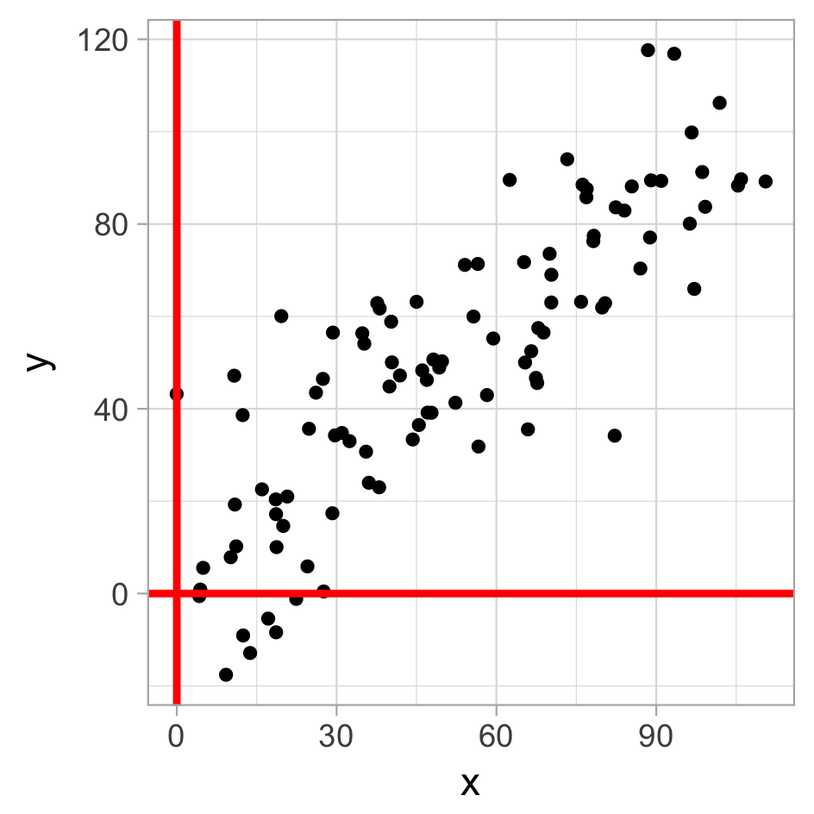
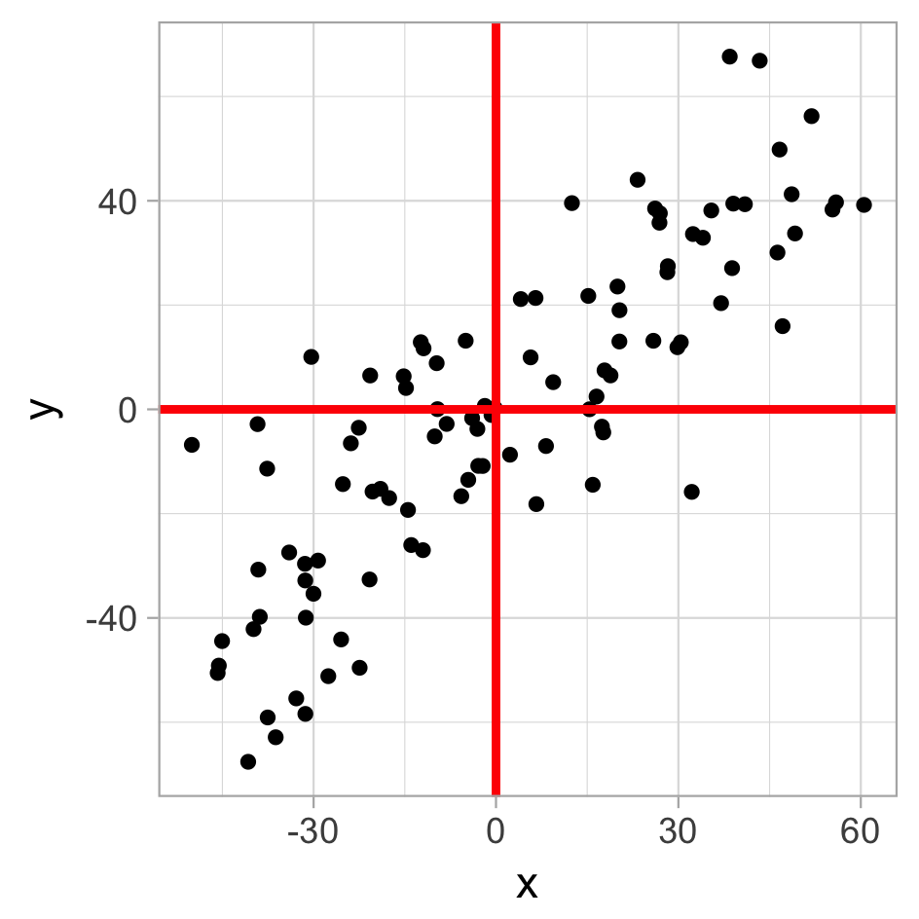
PCA algorithm step by step
Normalize the data
Calculate covariance matrix
Calculate eigenvalues and eigenvectors
Rank eigenvalues to choose feature vectors
Forming principal components

Slide 6
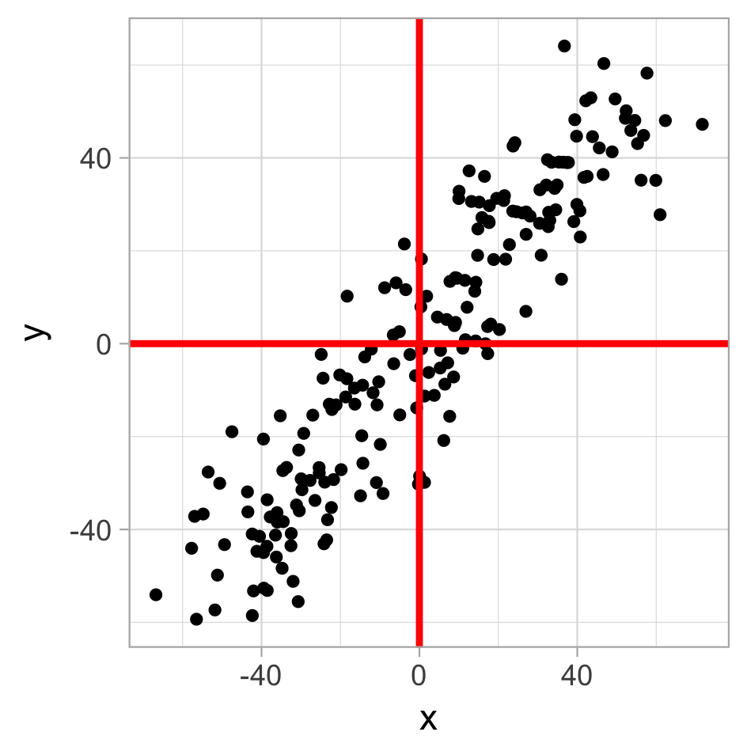
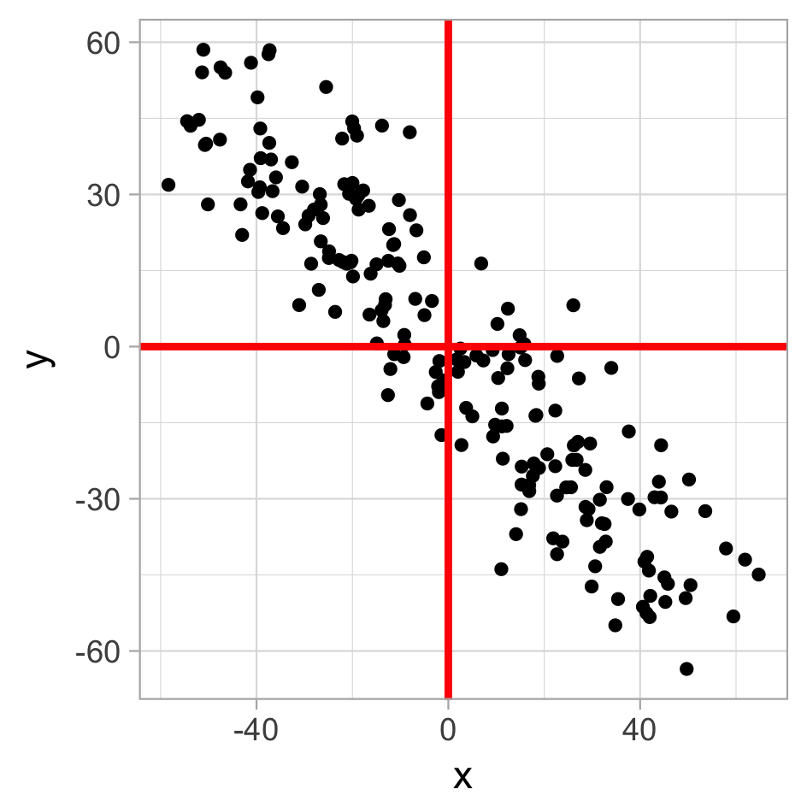
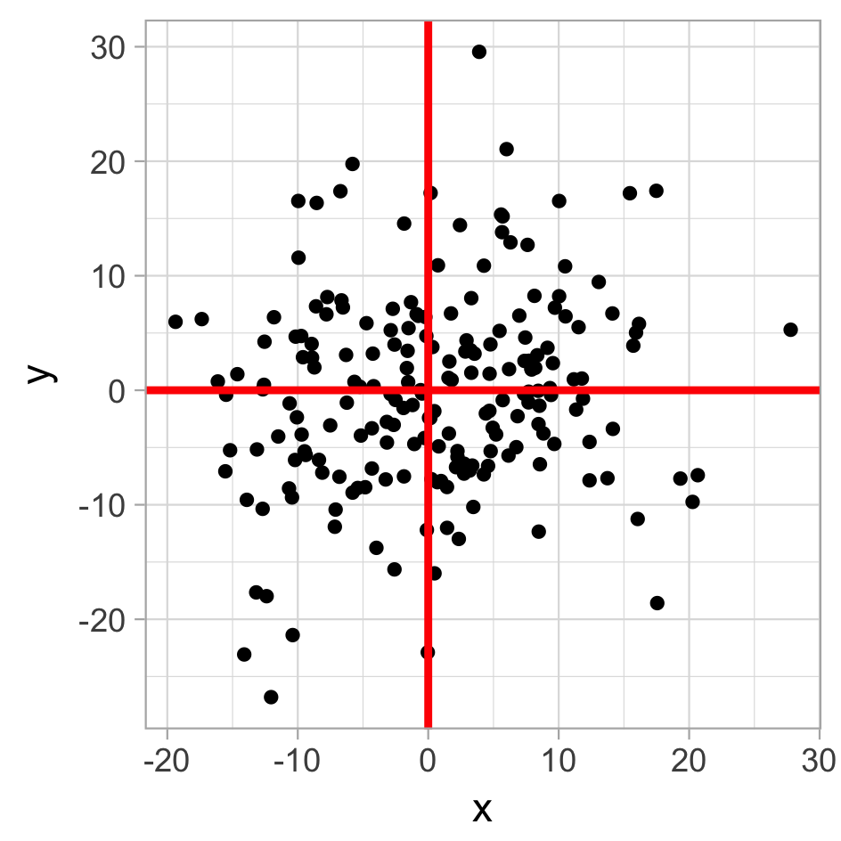
PCA algorithm step by step
cov(x, x) | cov(x, y)
cov(y, x) | cov(y, y)
Matrix (covariance) = [ ]
Normalize the data
Calculate covariance matrix
Calculate eigenvalues and eigenvectors
Rank eigenvalues to choose feature vectors
Forming principal components
984.8 | 905.9
905.9 | 991.3
[ ]
883.6 | -814.4
-814.4 | 905.6
[ ]
76.3 | 11.4
11.4 | 74.8
[ ]
Notes:
Covariance: a measure of the joint variability of two random variables

Slide 7
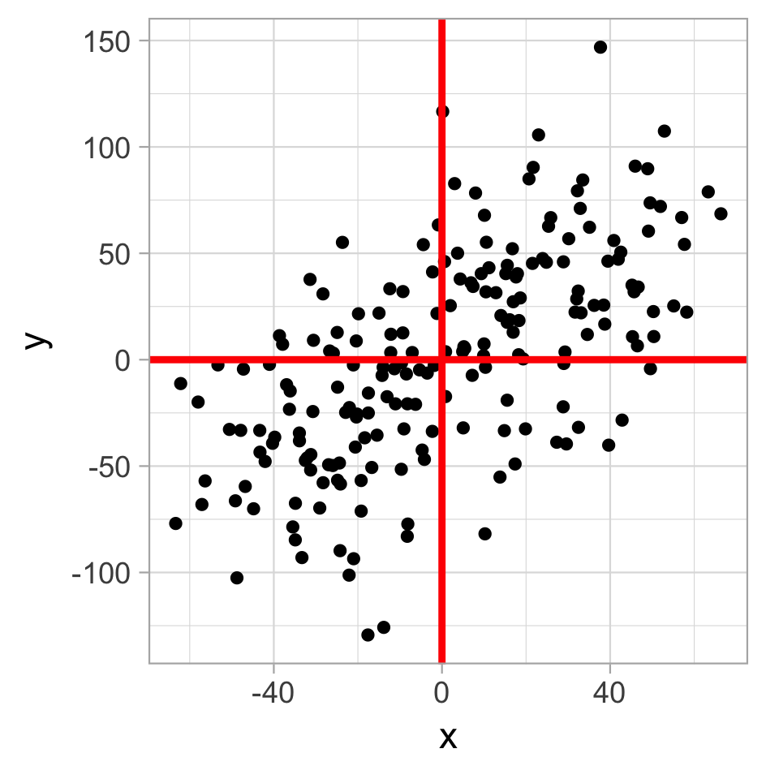
PCA algorithm step by step
cov(x, x) | cov(x, y)
cov(y, x) | cov(y, y)
A = Matrix (covariance) = [ ]
Av = ƛv
Normalize the data
Calculate covariance matrix
Calculate eigenvalues and eigenvectors
Rank eigenvalues to choose feature vectors
Forming principal components
984.8 | 905.9
905.9 | 991.3
[ ]
987.3 | 869.4
869.4 | 2764.4
[ ]
Notes:
Plot6
Plot7

Slide 8
PCA algorithm step by step
Normalize the data
Calculate covariance matrix
Calculate eigenvalues and eigenvectors
Rank eigenvalues to choose feature vectors
Forming principal components
Eigenvalue 1
Eigenvalue 2
Notes:
Plot6
Plot7

Slide 9
PCA algorithm
Normalize the data
Calculate covariance matrix
Calculate eigenvalues and eigenvectors
Rank eigenvalues to choose feature vectors
Forming principal components
PC2
PC1
Eigenvalue 1
Eigenvalue 2
Notes:
Plot6
Plot7

Slide 10
PCA summary
Build new coordination system to maximize variance in each dimension in new coordinate system
Use N coordinates with top variances to represent > N dimensions
Notes:
Ref:
https://medium.com/100-days-of-algorithms/day-92-pca-bdb66840a8fb
https://www.dezyre.com/data-science-in-python-tutorial/principal-component-analysis-tutorial

Slide 11
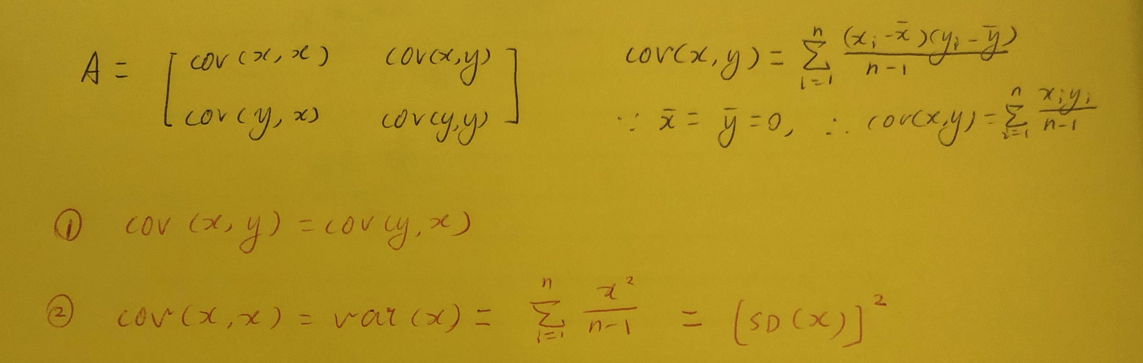
PCA algorithm (proofs)
Normalize the data
Calculate covariance matrix
Calculate eigenvalues and eigenvectors
Rank eigenvalues to choose feature vectors
Forming principal components

Slide 12
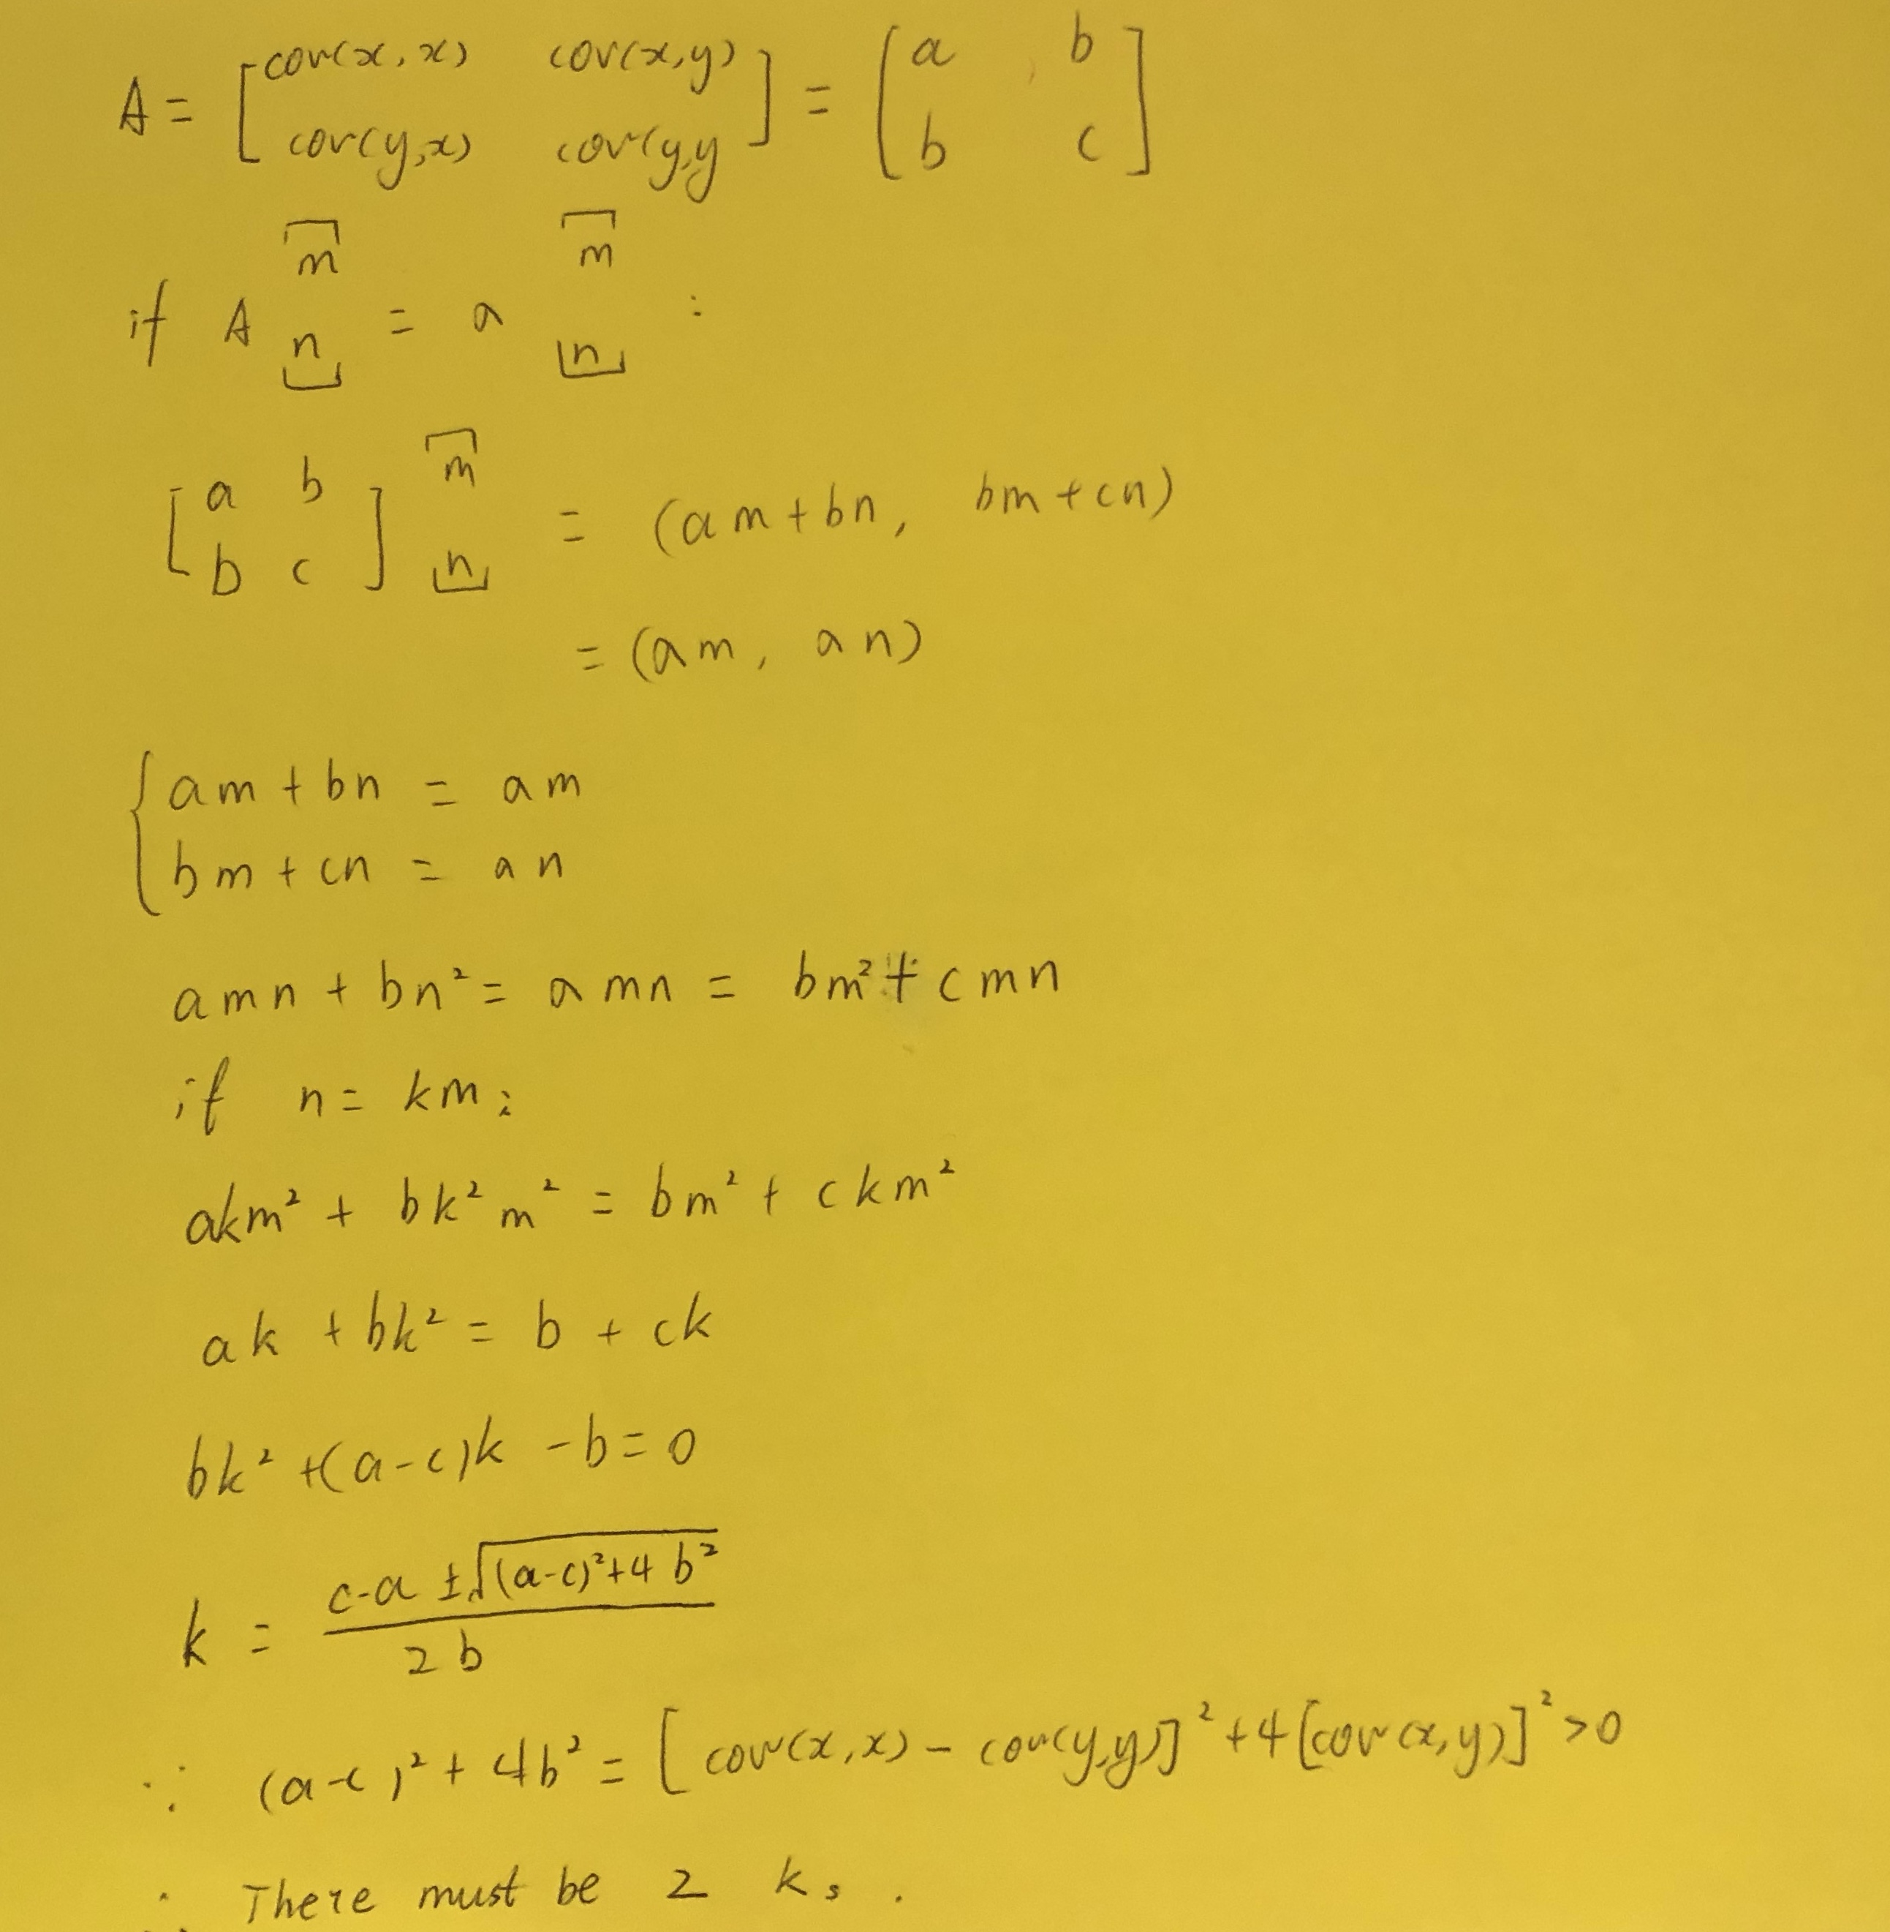
PCA algorithm (proofs)
There exist two an only two eigenvectors for
a 2x2 covariance matrix
Normalize the data
Calculate covariance matrix
Calculate eigenvalues and eigenvectors
Rank eigenvalues to choose feature vectors
Forming principal components

Slide 13
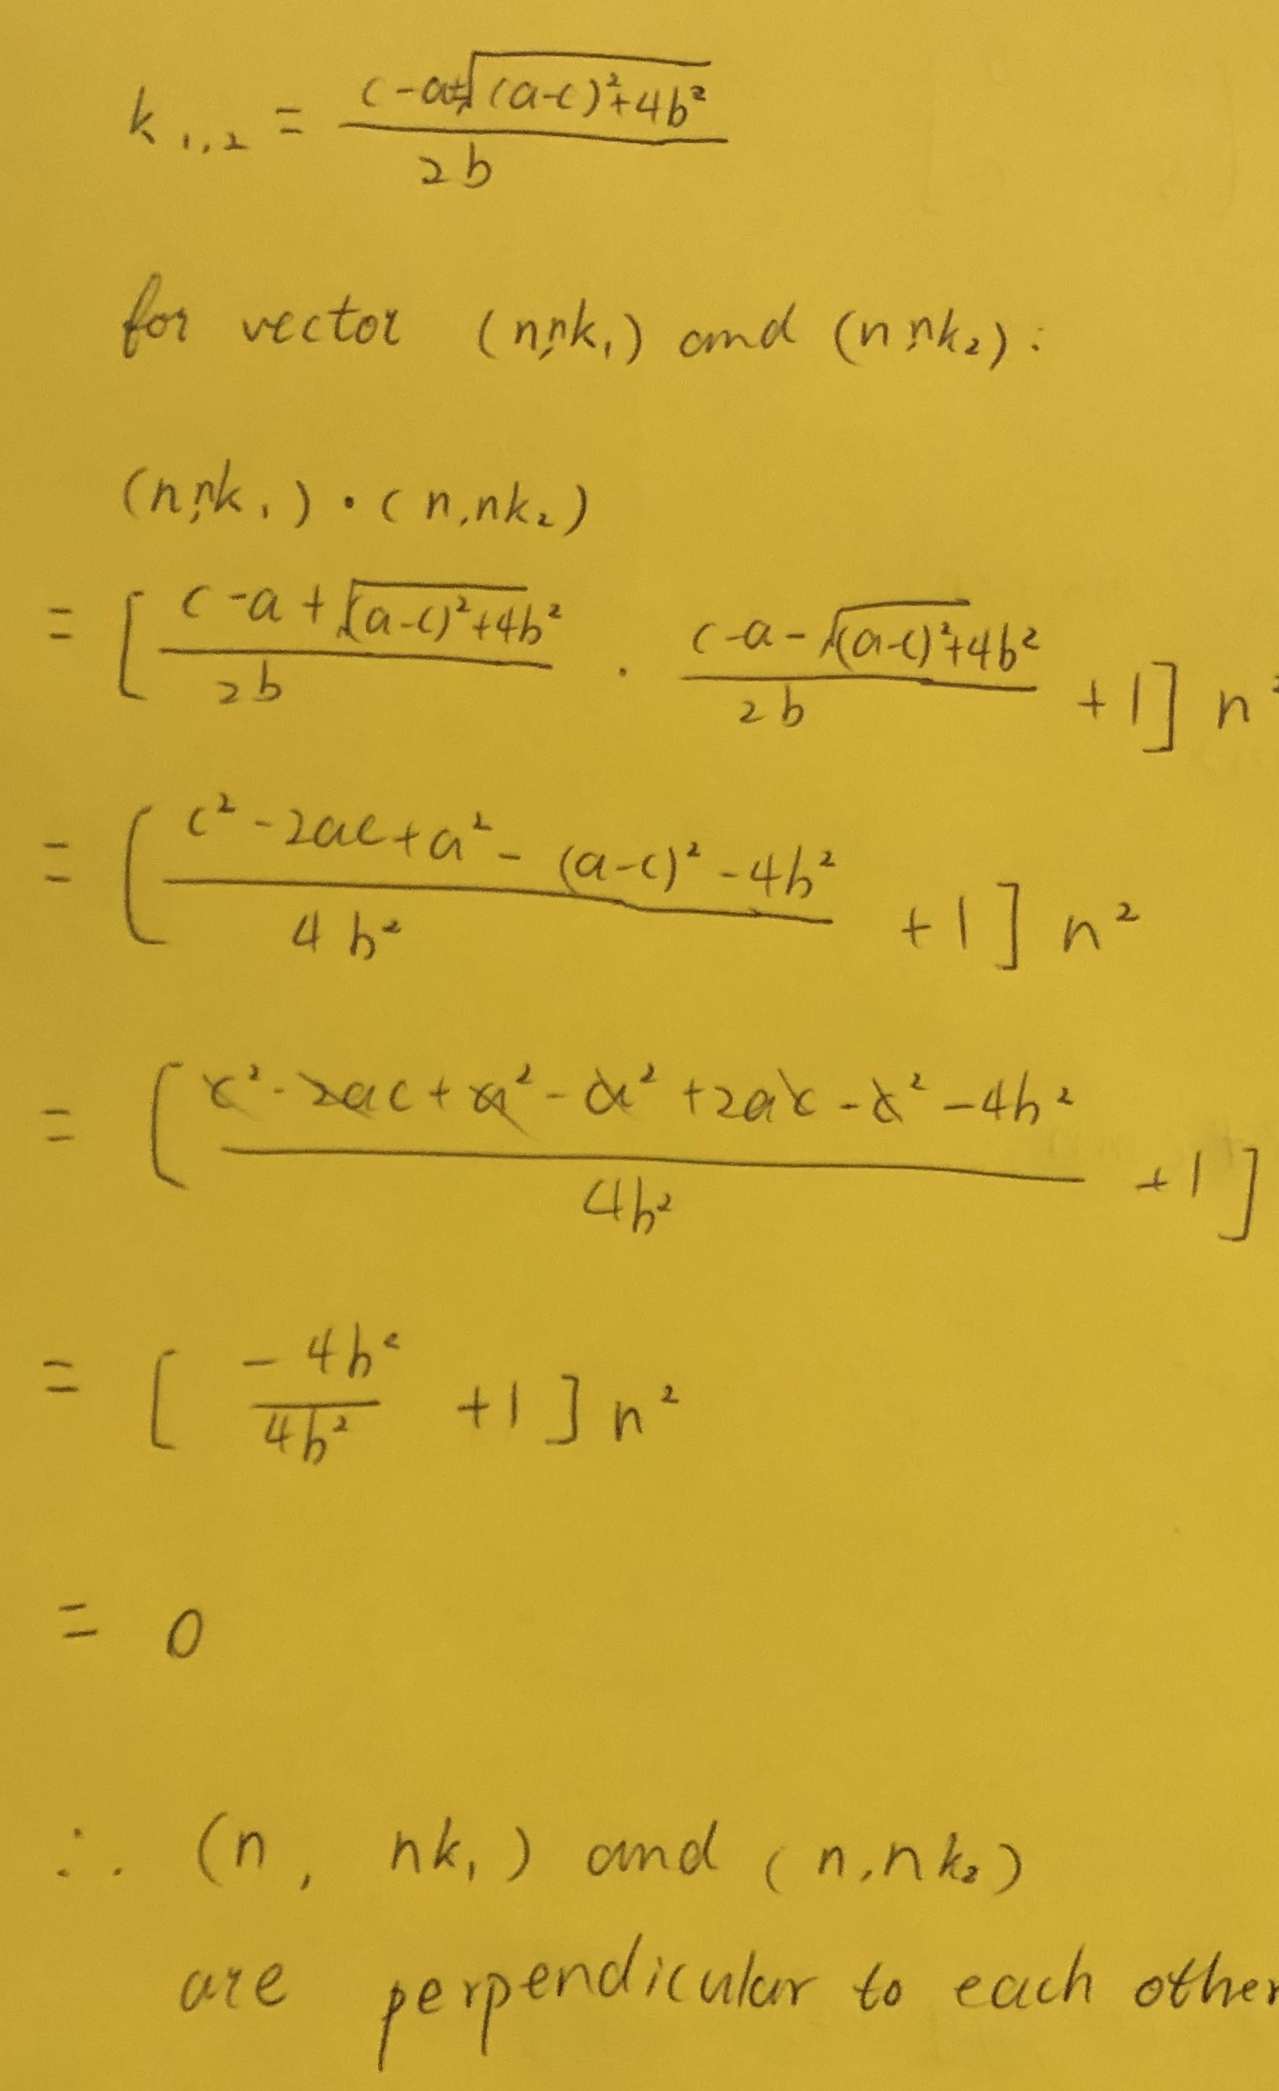
PCA algorithm (proofs)
The two eigenvectors are perpendicular to each other
Normalize the data
Calculate covariance matrix
Calculate eigenvalues and eigenvectors
Rank eigenvalues to choose feature vectors
Forming principal components

Slide 14
PCA has it’s limitations
PCA fail to reconstruct 3D brain regions
PCA perform poorly to reconstruct artificial dataset
with non-linear structure
Z Y Zun, 2009, Brain Folding Patterns
R. Ohbuchi, et. al., 2007, Adaptive Multimedia Retrieval
Not suitable for high dimensional data with small scale structures and / or non-linear
Notes:
https://www.researchgate.net/publication/43350217_Constructing_a_Dictionary_of_Human_Brain_Folding_Patterns

Slide 15
New algorithms are developed for reconstructing high-dimension shape
Python scikit-learn package
Notes:
http://scikit-learn.org/stable/auto_examples/manifold/plot_compare_methods.html

Slide 16
SNE (stochastic neighbor embedding)
Place high-dimensional dataset in low-dimensional space and preserve neighbor identities
GE Hinton, ST Roweis, 2003, Advances in Neural Information Processing

Slide 17
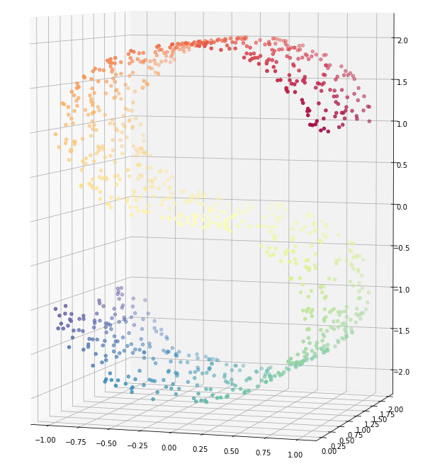
SNE step by step
Convert the high-dimensional Euclidean distances between data points into conditional probabilities that represent similarities
Use low-dimensional counterparts with similar conditional probability to represent high dimensional counterparts
Notes:
http://qiancy.com/2016/11/12/sne-tsne/

Slide 18
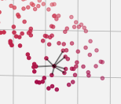
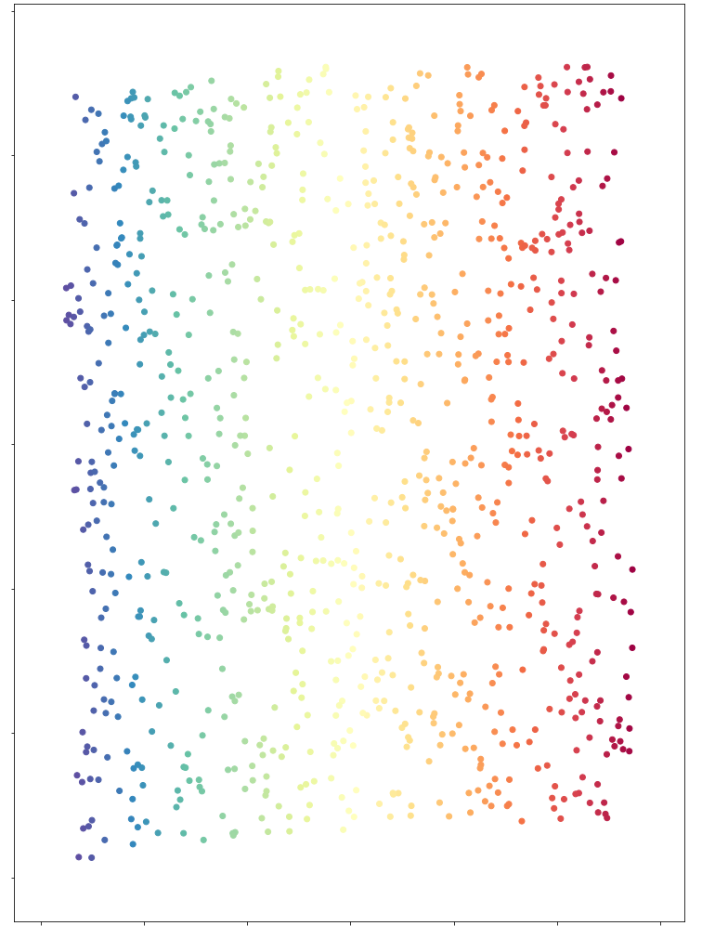
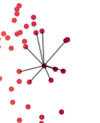
SNE step by step
Convert the high-dimensional Euclidean distances between data points into conditional probabilities that represent similarities
Use low-dimensional counterparts with similar conditional probability to represent high dimensional counterparts
3D
2D
Notes:
http://qiancy.com/2016/11/12/sne-tsne/

Slide 19
SNE step by step
Summary:
Neighboring probability calculation
Project to lower dimension
Weinberger Lab, Cornell
Notes:
http://qiancy.com/2016/11/12/sne-tsne/
https://blog.csdn.net/witnessai1/article/details/79377975

Slide 20
SNE v.s. t-SNE
Place high-dimensional dataset in low-dimensional space and preserve neighbor identities
GE Hinton, ST Roweis, 2003, Advances in Neural Information Processing
L Maaten, G Hinton, J Machine Learning Research, 2008

Slide 21
SNE v.s. t-SNE
Place high-dimensional dataset in low-dimensional space and preserve neighbor identities
GE Hinton, ST Roweis, 2003, Advances in Neural Information Processing
L Maaten, G Hinton, J Machine Learning Research, 2008
How are you supposed to do machine learning if you can’t even do human learning

Slide 22
SNE v.s. t-SNE
SNE
+
In neighboring probability calculation, use t-distribution instead of normal distribution
t-SNE
Notes:
https://bindog.github.io/blog/2016/06/04/from-sne-to-tsne-to-largevis/

Slide 23
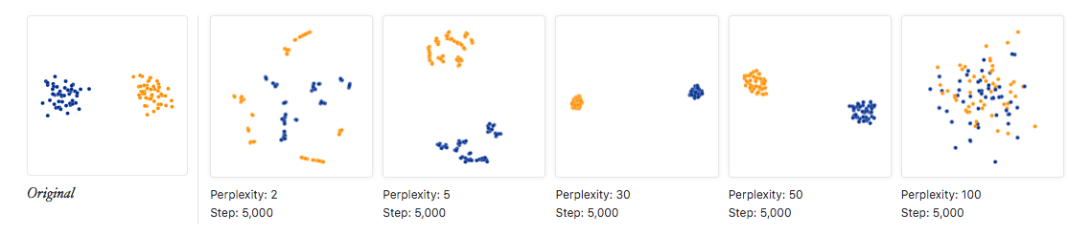
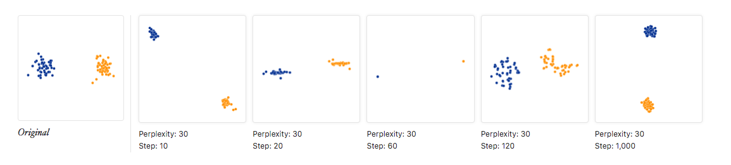
t-SNE parameters
Perplexity
Higher perplexity: more neighbors, lower sensitivity to small scale structure
Lower perplexity: less neighbors, higher sensitivity to small scale structure
Iterations
When trying to reduce divergence between high-dimensional data and low-dimensional projection, how many times it iterate
https://distill.pub/2016/misread-tsne/
Notes:
https://distill.pub/2016/misread-tsne/
http://www.datakit.cn/blog/2017/02/05/t_sne_full.html
http://blog.cytobank.org/2017/01/17/fine-tune-visne-to-get-the-most-of-your-single-cell-data-analysis/
https://lgatto.github.io/IntroMachineLearningWithR/unsupervised-learning.html

Slide 24

t-SNE practice: recognize hand-written dataset
Notes:
https://github.com/oreillymedia/t-SNE-tutorial

Slide 25
t-SNE limitations
Usually can only used for data visualization
Can not be used for dataset with high intrinsic dimensionality
Does not have a optimized output
Slow
Algorithm can not be supervised
Notes:
http://www.datakit.cn/blog/2017/02/05/t_sne_full.html
https://bindog.github.io/blog/2016/06/04/from-sne-to-tsne-to-largevis/

Slide 26
Classification of algorithms
Supervised / unsupervised
Dimension reduction classificatoin
https://www.slideshare.net/xuyangela/nonlinear-dimension-reduction
https://www.kdnuggets.com/2018/04/supervised-vs-unsupervised-learning.html
Notes:
https://www.jiqizhixin.com/articles/2017-08-31-2
Manifold learning: https://www.zhihu.com/question/24015486

Slide 27
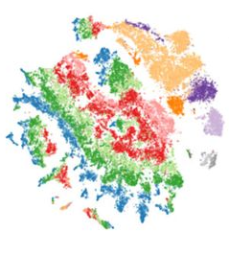
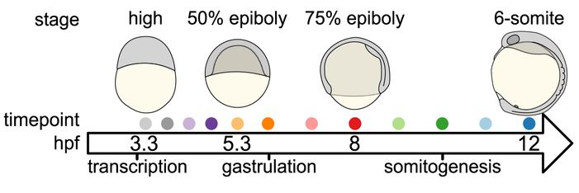
Case Study: Zebrafish embryogenesis
J. Farrel, A. Regev, A. F. Schier, et. al; SCIENCE; 2018

Slide 28
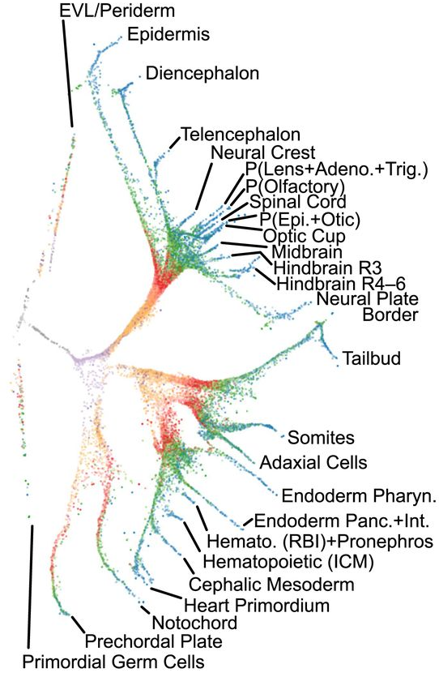
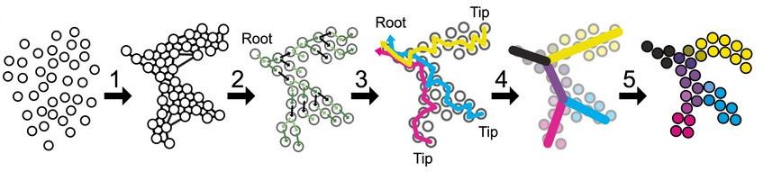
Case Study: Zebrafish embryogenesis
J. Farrel, A. Regev, A. F. Schier, et. al; SCIENCE; 2018

Slide 29
Q&A

